Slide 1

Lloyds Banking Group AVD Bicep Workshop (day 2)
START: 09:30
AVD Web Client (if required): https://client.wvd.microsoft.com/arm/webclient/index.html
Git repo: https://github.com/mikerossms/AVD-Bicep-Workshop-LBG.git
John Saville: https://www.youtube.com/channel/UCpIn7ox7j7bH_OFj7tYouOQ
Resource abbreviations: https://learn.microsoft.com/en-us/azure/cloud-adoption-framework/ready/azure-best-practices/resource-abbreviations
Michael Ross (CSA)

Slide 2
Agenda – Day 2
09:00 – Review of Day 1
09:30 – Infrastructure – Lab 2
10:15 – Break
10:30 – Infrastructure – Lab 2
12:00 – Lunch
13:00 – AVD components – Lab 3
15:00 – Break
15:30 – AVD Components – Lab 3
16:30 – Q&A and Review

Slide 3

The Plan - Reminder

Slide 4
The Plan
So what will we build?
Diagnostics using Log Analytics and Storage Account
Simple network infrastructure
Keyvault
Hostpool + Workspace and Application Group
Hosts
And the outcomes?
Learn Bicep in practice
Learn how an AVD solution hangs together including resources, hosts and identities
A basic working AVD solution that you can log into using a provided identity

Slide 5
The Architecture

Slide 6
Break Time Back in 15 mins 10:10
"Infrastructure as code: because who doesn't love spending their days automating things that used to be done manually and breaking things in new and exciting ways?”

Slide 7
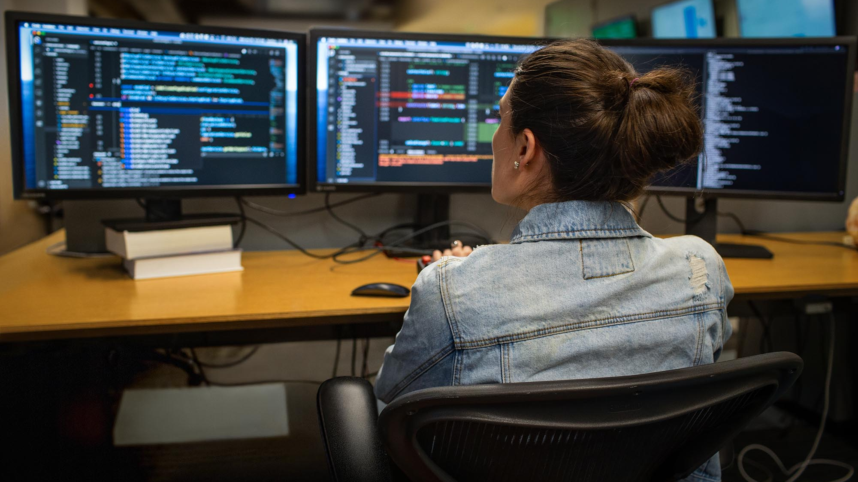
Lab 2 - Infrastructure

Slide 8
Lunch Back in 1 hour Back: 13:10
"Using Azure Bicep is like having a sous chef for your cloud infrastructure. It takes care of the heavy lifting, so you can focus on the creative aspects of building your application. Just don't let it near your recipe book - you never know what kind of cloud-native concoctions it might come up with!"

Slide 9
Base Infrastructure
Getting the foundations right
In this session we will build on Lab 1 and start thinking about how to manage and build the Bicep Code.
We will be aiming to cover the following in this session
The Backplane (walkthrough)
Keyvault
NSG, Virtual Network and Subnet
Peering (walkthrough)

Slide 10
Deploying your Bicep
So what has changed?
As you are now aware, deploy.ps1 is used to deploy your code. This time there are several other options in play depending on where you are in the deployment:
As before, the script takes several parameters but now two are mandatory.
.\deploy.ps1 -uniqueIdentifier “your username" -avdVnetCIDR "provided CIDR“
e.g.
.\deploy.ps1 -uniqueIdentifier “mike" -avdVnetCIDR “10.140.0.1/24“
Notes:
Always use the same CIDR and Unique ID when deploying to avoid conflicts.
To save time, take a look at the README.md – it provides examples of some of the other parameters.

Slide 11
Lab 3 – AVD Components

Slide 12
AVD Components
The AVD Base Components
In this session we will build on lab 2 and the infrastructure we have deployed. This lab will focus on the building of the AVD components.
We will be aiming to cover the following in this session:
Host Pool
Application Group
Workspace
Remember: This is first and foremost a course about learning Bicep. These labs will require you to put your thinking caps on. Remember to collaborate, ask questions and used the reference material to find the answers.

Slide 13
Break Back in 15 mins
"Using Azure Bicep is like a carpenter using power tools for the first time. It can be scary at first, but once you get the hang of it, you'll wonder how you ever managed without it. And just like with power tools, you'll want to make sure you wear your safety glasses and have a first-aid kit handy!“
Mark Russinovich, CTO of Microsoft Azure

Slide 14

Q&A and Review

Slide 15

See you all tomorrow

